Slide 1
Pwm final project
Name: Mohamed abdrabou mohamed

Slide 2
Components Used
2 Micro-controller Atmega32
Lcd

Slide 3
Drivers
LCD
DIO
PWM {timer}
TIMER1 INPUT CAPTURE UNIT

Slide 4
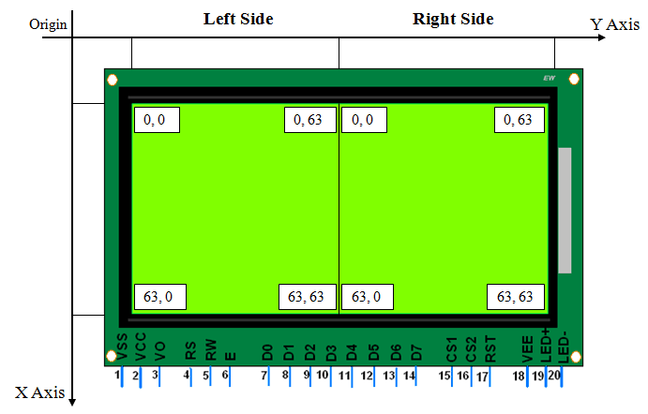
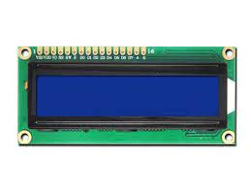
LCD
16x2
Mode is four bits

Slide 5
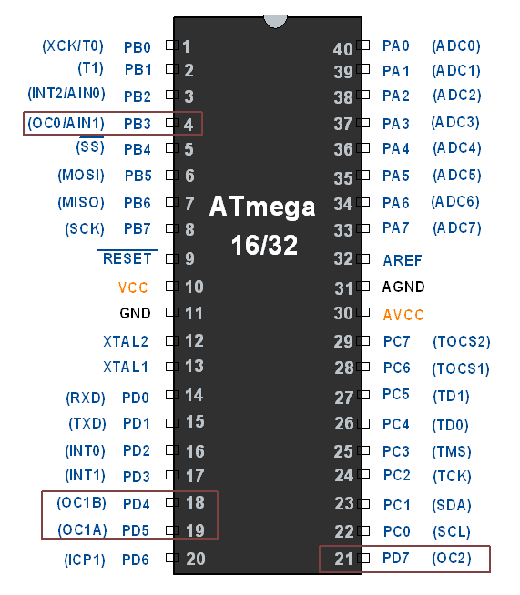
PWM
PWM out Pins on AVR ATmega16/32
Used fast PWM mode with non-inverted output
Ocr0 =Compare match
No prescaler

Slide 6
start
start
GLCD init
PWM init
Output PWM signal
a<b && b<c
NO
erorr
YES
stop
Calculate Freq,Duty Cycle
Print Freq,D_C
stop

